Slide 1
LEARNINGMANAGEMENT SYSTEM
LMS

Slide 2

WELCOME MESSAGE
HERE IS YOUR SUBTITLE
Welcome to the E-Learning system. Here students as well as educational institutes will be entertained, by provided a fully user friendly environment for learning as well as management and entrainment.
-ABDULLAH FAROOQ
051-BSCS-2019-SECTION-C
abdullahfarooq20172018@gmail.com

Slide 3

Problem
In current situation of Epidemic environment, students as well as educational institutes, are facing many problems doe example:
Study related problems
Management related Problems
Examination related Problems
Contacting Teachers related problems for students
Study Related Queries
Commencing Lectures
Scheduling Lectures
Commencing Assignments
The problem can be solved by providing a user friendly platform. A platform, where students, teachers and institute management can work on their sides by staying at home. This platform can be named as Learning Management System(LMS) or E-Learning System.

Slide 4
solutions
Write main solutions you are providing
Login
Signup
Logout
User can login to his/her account with high security protocol/ measures.
User can create his/her account following strong measures.
User can easily logout his/her account without losing data.
Management
Teacher
User can login as a teacher and perfume his/her duty accordingly.
Like marking student attendance, grading students, conducting examination.
Student
User can login as management and perfume his/her duty accordingly. For Example:- admitting students, generating fee challan , generating pay slips, check and balance users.
.
User can login as student and perfume his tasks accordingly. For example:- Checking attendance, perfurming examinations.
Attendance
Subject
Data class
User can mark his attendance can check his attendance of previous and recent updates.
Management can assign a subject to a teacher as well as students. Teacher can marks of his/her students.
The program saves and loads data from this class.

Slide 5
solutions
Write main solutions you are providing
Timetable
Lecture
Entertainment
Management uses can create timetable for students as well as teachers.
Management uses can set semester and section and teacher users and student users.
User can listen audios and play games.

Slide 6
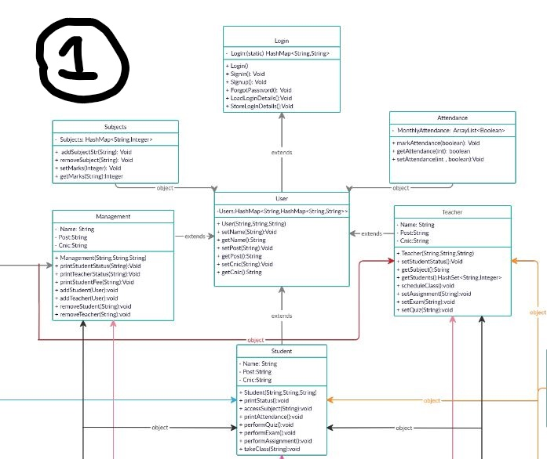
Proposed Class Diagram

Slide 7
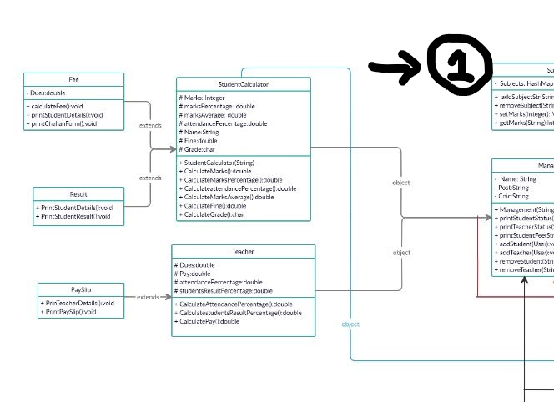
Proposed Class Diagram

Slide 8
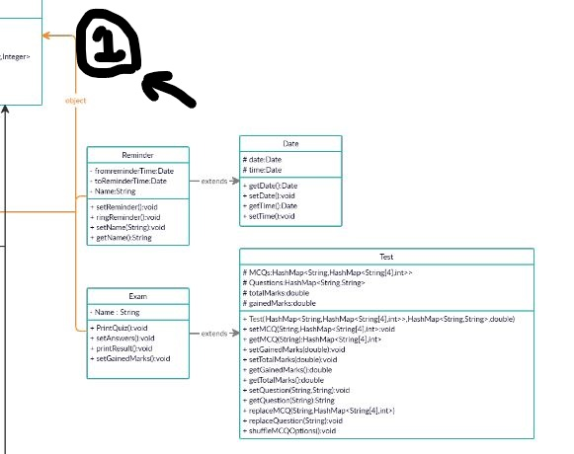
Proposed Class Diagram

Slide 9
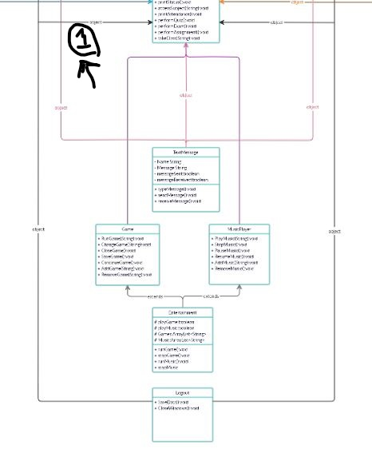
Proposed Class Diagram

Slide 10
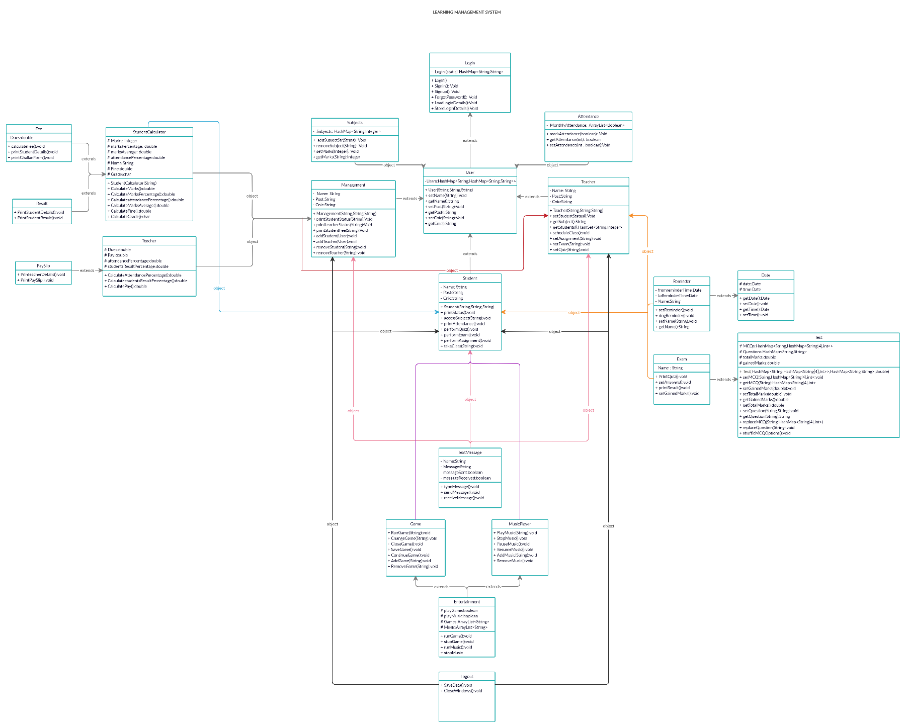
Proposed Class Diagram (complete)

Slide 11
Class Diagram of submitted project
Sir the class diagram was too high dimensional that it won’t fit here so the file is in about me folder naming “My Class Diagram.

Slide 12
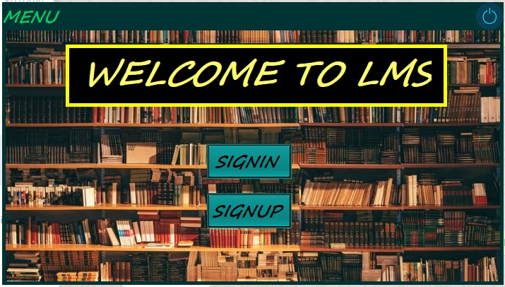
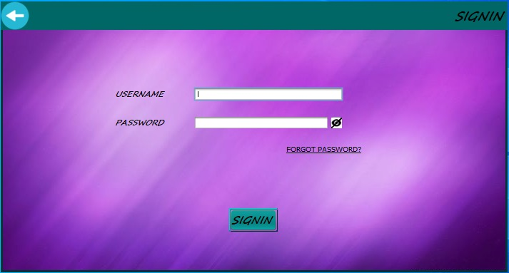
Screenshot of solution
Menu
Sigin

Slide 13
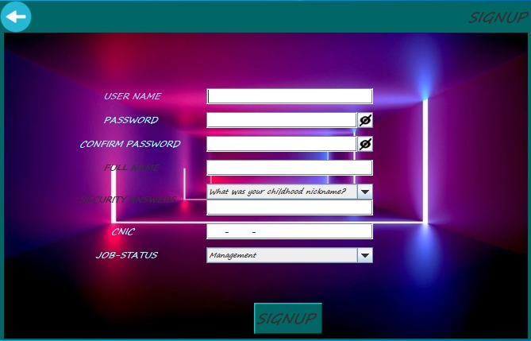
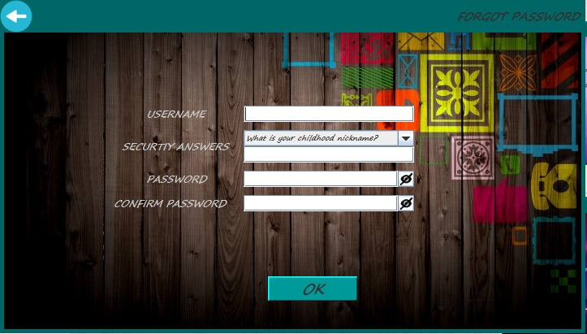
Screenshot of solution
Signup
Forget password

Slide 14
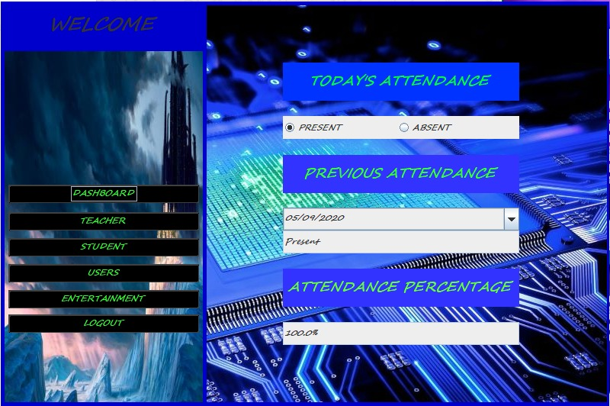
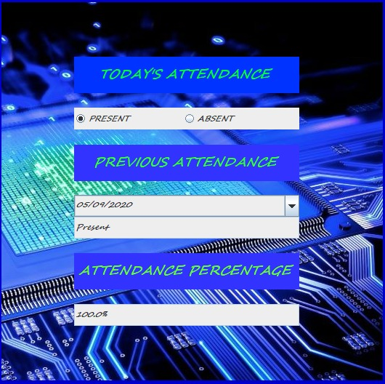
Screenshot of solution
Managenment
Dash board

Slide 15
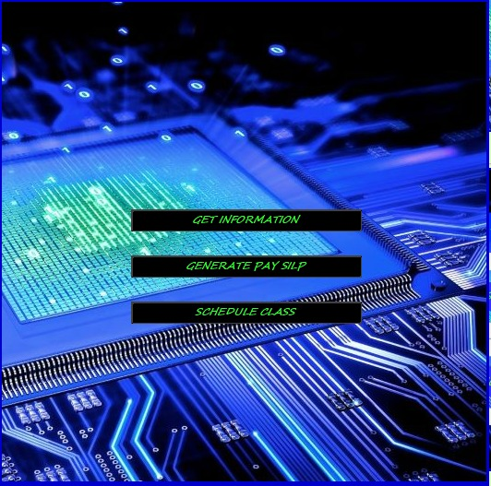
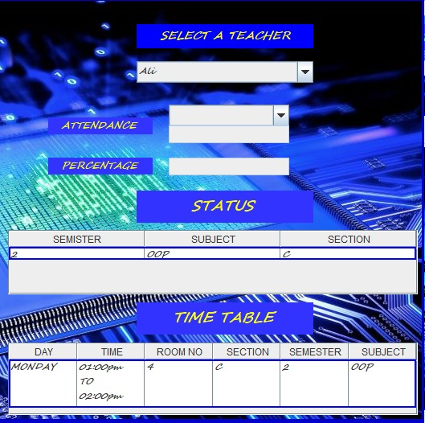
Screenshot of solution
Manage teacher
Get teacher information

Slide 16
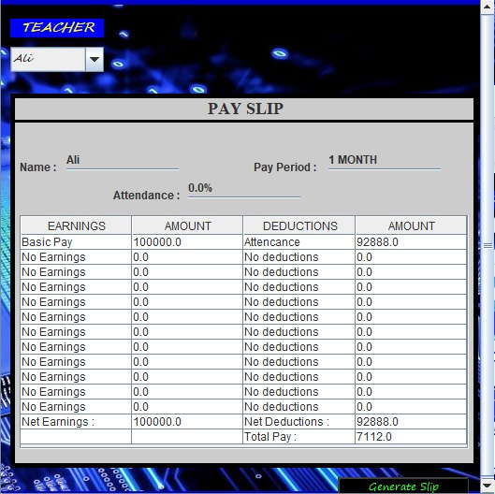
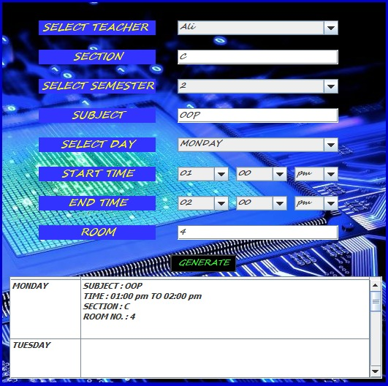
Screenshot of solution
Generate teacher pay slip
Schedule time table

Slide 17
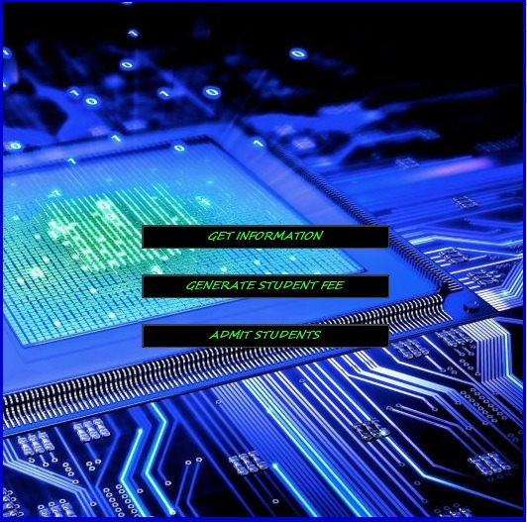
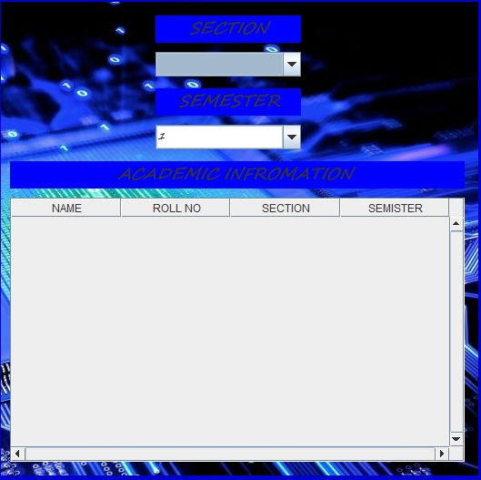
Screenshot of solution
Manage students
Get students information

Slide 18
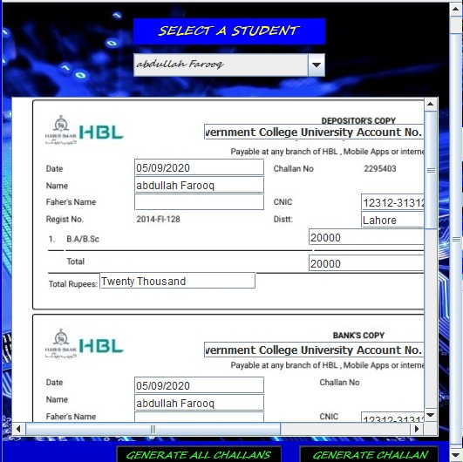
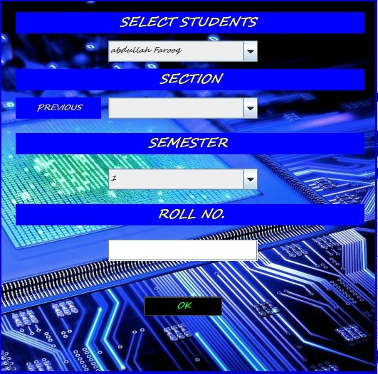
Screenshot of solution
Generate student fee slip
Admit a student

Slide 19
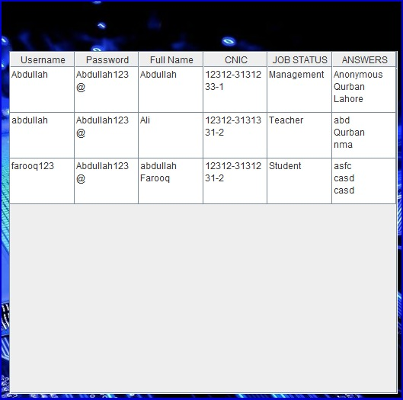

Screenshot of solution
User information
Entertainment

Slide 20
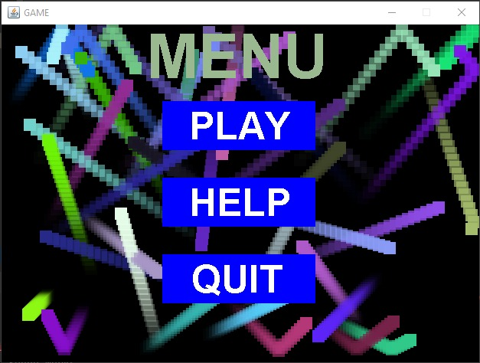
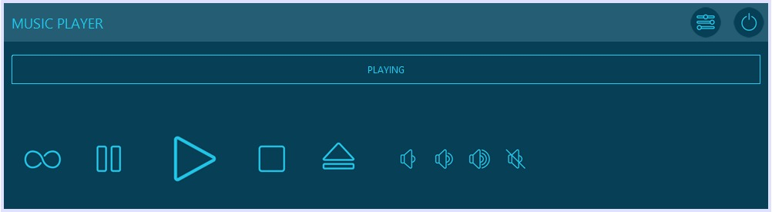
Screenshot of solution
Game
Audio player

Slide 21
THANK YOU
Project name: Learning Management System
Name: Abdullah Farooq
Roll number: 0051-BSCS-19
Email: abdullahfarooq20172018@gmail.com
Section: C

